Slide 1
TIC TAC TOE - AI
USING THE MINI-MAX ALGORITHM

Slide 2
Table of Contents
MINI-MAX ALGO
CODE REVIEW
We will understand what the algorithm actually is.
Walk through the code of the game
RUNNING THE GAME
Q+A SESSION
We will see the execution of the game
We will conclude with a Q&A session

Slide 3
01
THE MINI-MAX
ALGORITHM

Slide 4
WHAT IS MINI-MAX ALGORITHM
IT IS A RECURSIVE ALGORITHM AND COMES UNDER GAME THEORY.
THERE WILL BE TWO MAIN FUNCTIONS - MINIMIZE & MAXIMISE
THE MAXIMIZE FUNC. WILL CALL THE MINIMIZE FUNC AND THE MINIMIZE WILL LIKE WISE CALL MAZIMIZE.
THE RECURSIVE LOOP BREAKS WHEN THE FOLLOWING CONDITIONS ARE MET -
1. BOARD IS FULL
2. SOMEONE HAS WON THE GAME
.

Slide 5
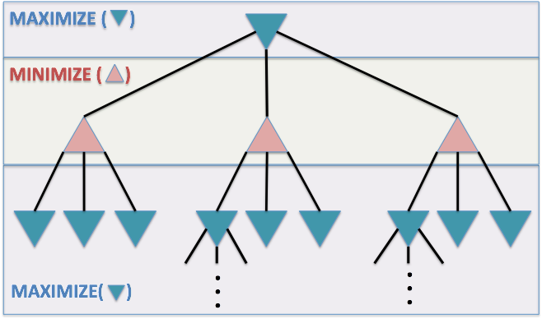
RECURSIVE TREE

Slide 6
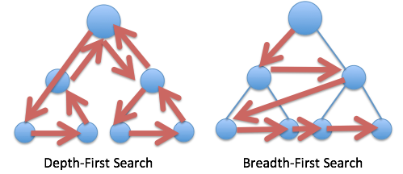
DEPTH FIRST

Slide 7
02
THE GAME IN ACTION

Slide 8
BACK TO THE SLIDES!
I HOPE YOU COULD CLEARLY SEE THE GAME
It is simple & beginner friendly
You can learn a bit about game theory and explore further
Most importantly it is FUN

Slide 9
03
THE CODE
ANALYSIS

Slide 10
The functions used in the program
printBoard
isWinner
PRINTS THE TIC TAC TOE BOARD
CHECKS CONDITION FOR WINNING THE GAME

Slide 11
The functions used in the program
CompMove
isBoardFull
This is the main mini-max algorithm in action and the computer’s move is decided by this
THIS FUNCTION CHECKS THE AVAILABILTY OF FREE SPACES FOR THE NEXT MOVE

Slide 12

The full code can be found on my github !
SAMMMYYY233

Slide 13
OVERVIEW
THANK YOU !
BASIC UNDERSTANDING OF MINI-MAX
BUILDING A BEGINNER
FRIENDLY PROJECT
EXPLORE !

